Slide 1

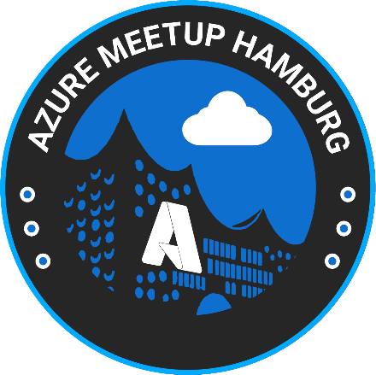

Azure Container Apps
In Action
Ryan Niño Dizon
Software Development Lead/Software Architect at ISD Feniqs

Slide 2
Agenda
Setting common understanding
Demo
Create ACA via Azure Portal and explore
Create/Deploy ACA via locally
Use AZD to work with ACA
AZD templates

Slide 3



Ryan Niño Dizon
@ryanninodizon
/in/ryanninodizon
ryannninodizon
@ryanninodizon youtube.com/@LearnWithJon

Slide 4
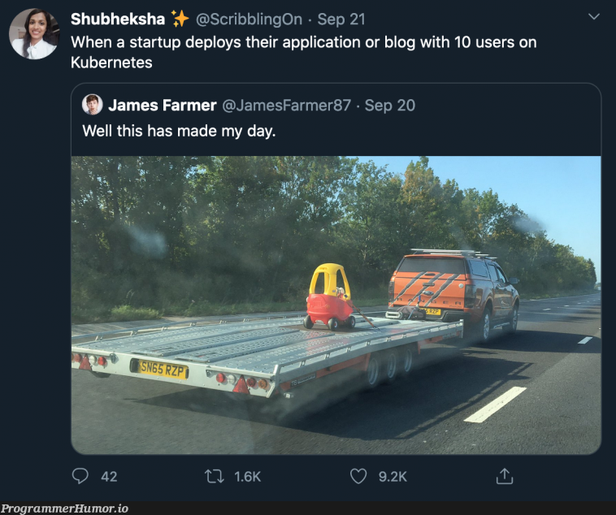
Introducing Azure Container Apps
Kubernetes is really good but I hate yaml files
ACA still uses Kubernetes
ACA as Serverless – scale to zero
ACA is not a solution for all scenario
ACA plans:
Consumption
Dedicated

Slide 5
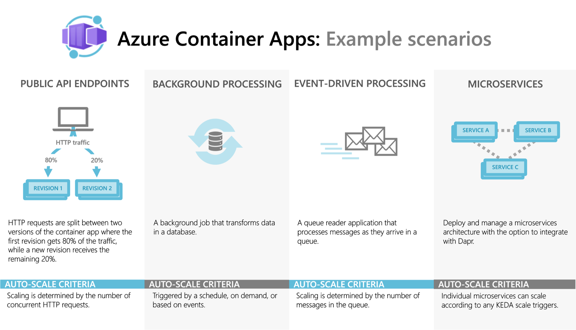
Introducing Azure Container Apps

Slide 6
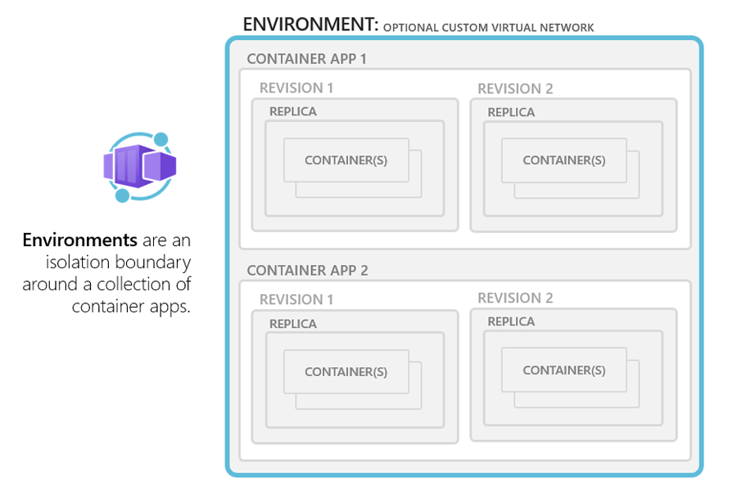

Slide 7
Demo

